Slide 1

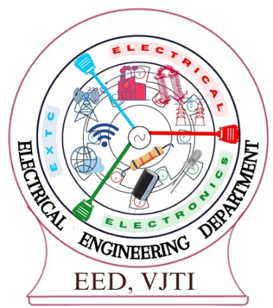
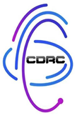
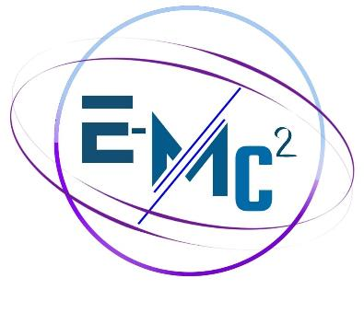
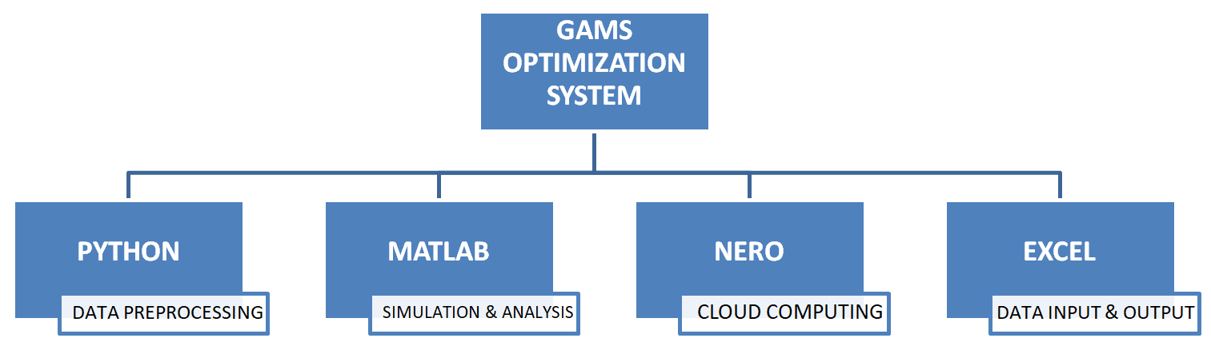
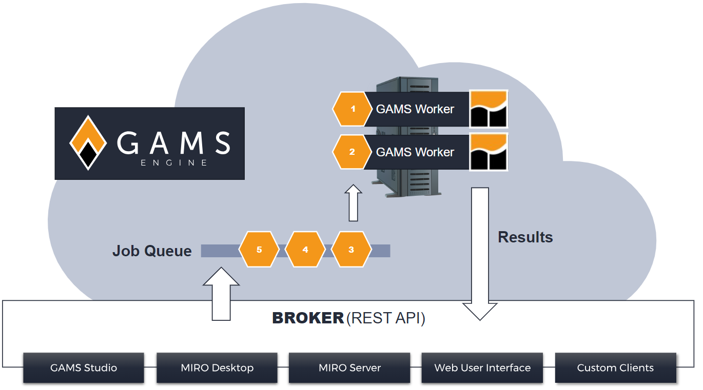
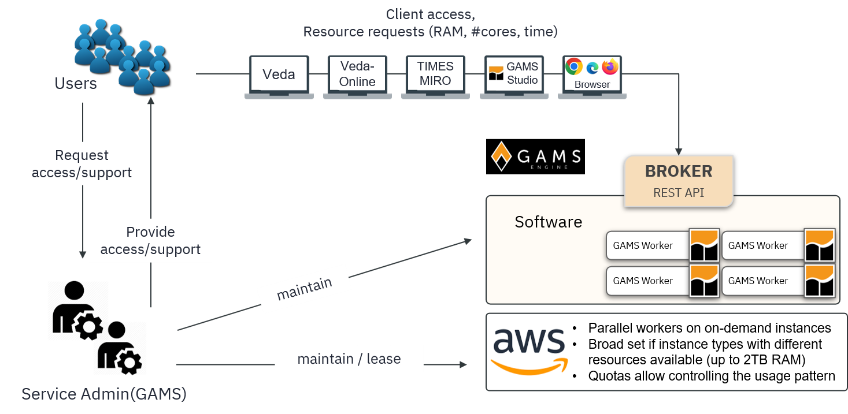
“Power System Applications Using GAMS Software”
VJTI
YUKTA DETHE
M-TECH POWER SYSTEM SEM - II
Introduction to GAMS :
General Algebraic Modeling System is a high level modeling system for mathematical optimization.
Widely used in energy, economics, and engineering optimization problems.
Role in Economic Dispatch :
Optimized Generation: Allocates power among generators to minimize costs.
Cost Efficiency: Reduces fuel costs by using the most economical power sources.
Supply-Demand Balance: Ensures power generation meets consumer demand reliably.
Key Benefits of Combining GAMS & Pyomo :
Faster solutions for large-scale power dispatch.
More flexibility with data integration & visualization.
AI-powered optimization for smart grid applications.
Seamless cloud-based ED execution with GAMS Engine.
(c)
Advantages of Using GAMS :
Fast prototyping and model scalability.
Integration with industry-standard tools enhances usability.
Robust solver support for diverse optimization challenges.
Future Prospects :
AI & Machine Learning integration with GAMS for power systems.
Advanced energy market modeling for deregulated power grids.
Smart grid applications for real-time optimization.
Conclusion :
GAMS is a powerful tool for optimizing power system applications, providing efficient solutions for Economic Dispatch, Unit Commitment, Optimal Power Flow, and Renewable Energy Integration.

